Slide 1
Telecom Customer Churn Prediction
Capstone Project 1

Slide 2
Introduction
Customer churn, also known as customer attrition, customer turnover, or customer defection, is the loss of clients or customers.
Churn rate is the amount of customers or subscribers who cut ties with the service or company during a given time period. These customers have "CHURNED".
Telephone service companies, e-commerce companies, internet service providers, pay TV companies, insurance firms, etc., often use customer churn analysis and customer churn rates as one of their key business metrics because the cost of retaining an existing customer is far less than acquiring a new one.

Slide 3
Problem at hand
Predicting the behaviour of the customers leading to churn.

Slide 4
Value to the client
A telecom company has been affected by the increasing number of customers subscribing to the services of a competitor.
It is much more expensive to attract new customers than retaining old customers.
At the same time, spending too much on or spending on the wrong factor for retaining a customer who has no intention to leave could be a waste of money.
Therefore it is important to identify the customer who has high probability of leaving. An analysis of the past records of the customers can give great insights on who might leave and what is the cause.
We can predict behaviour to retain customers. We can analyze all relevant customer data and develop focused customer retention programs.

Slide 5
DATA WRANGLING
The data was obtained from Kaggle and was very clean and required minimal data cleaning steps.
The data contains 7043 rows (customers) and 21 columns (features).
The column 'TotalCharges' had 11 rows with spaces. Tenure for all these 11 exact rows is also 0, churn is "No" as well. One can interpret this as belonging to all new customers, if indeed these are the only rows with tenure = 0 too. Hence we can set 'TotalCharges' to 0, whenever tenure is 0. So the spaces were converted to 0.
The 'customerID' column is of no use to us, so it was removed from the DataFrame.

Slide 6
EXPLORATORY DATA ANALYSIS
Here we are going to ask and answer a few questions about the data with respect to our dependent variable and also visualize & get insights from it.
Target (Dependent) Variable: Churn
Feature (Independent) Variables: 19 variables out of 20.
We can divide the independent variables into:
Person specific : gender, SeniorCitizen, Partner, Dependents, tenure
Service specific :
o Phone : PhoneService, MultipleLines
o Internet : InternetService, OnlineSecurity, OnlineBackup, StreamingTV, StreamingMovies, TechSupport, DeviceProtection
Money specific : MonthlyCharges, TotalCharges, Contract, PaperlessBilling, PaymentMethod

Slide 7
The questions to which we seek answers:
Is there a gender specific to churn?
Are there any person specific trends in churn?
Is there a correlation between tenure and churn?
Is there a correlation between certain types of services and churn?
Is there a correlation between different types of contract and churn?
Is there a correlation between paperless billing and churn?
Is there a correlation between different types of payment methods and churn?
Is there a correlation between monthly charges and churn?
Is there a correlation between total charges and churn?
Is there a correlation between monthly charges and total charge with respect to churn?
Is there a correlation between monthly charges and tenure with respect to churn?
Is there a correlation between total charges and tenure with respect to churn?

Slide 8
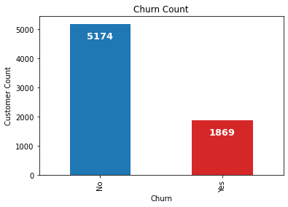
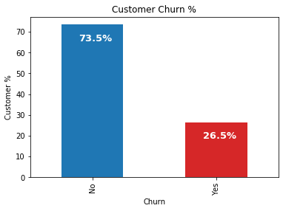
Customer Churn in the data:
First let us check out the number of customers who have churned or not churned.
So, we can see from above -
Churn No - 5174 or 73.5%
Churn Yes - 1869 or 26.5%

Slide 9
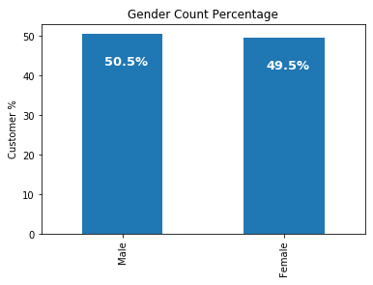
Gender distribution:
Let's see the gender distribution in the dataset.
We can see that the gender distribution looks balanced.

Slide 10
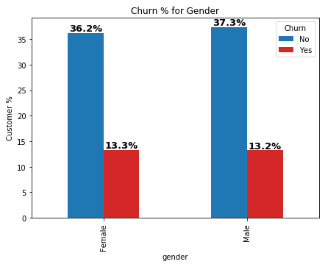
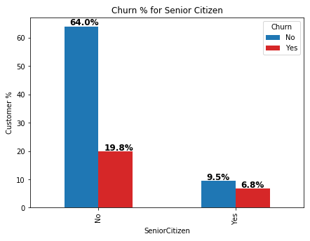
Visualizing the customer's attributes with respect to Churn:
Person specific attributes -
Gender
The churn rate is not affected by gender.
Senior Citizen
Senior Citizens tend to churn less compared to non-senior citizens.

Slide 11
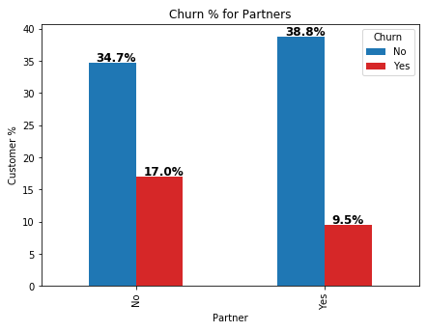
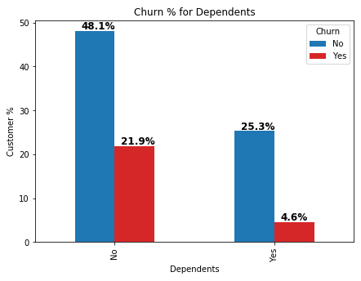
Partners
Customers who don't have partners have a higher churn rate.
Dependents
Customers without dependents have a higher churn rate.

Slide 12
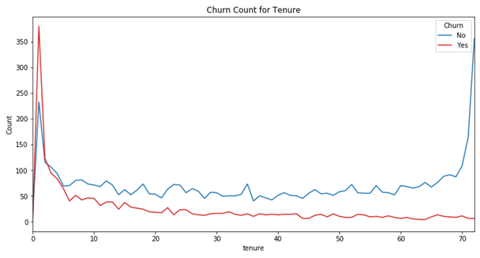
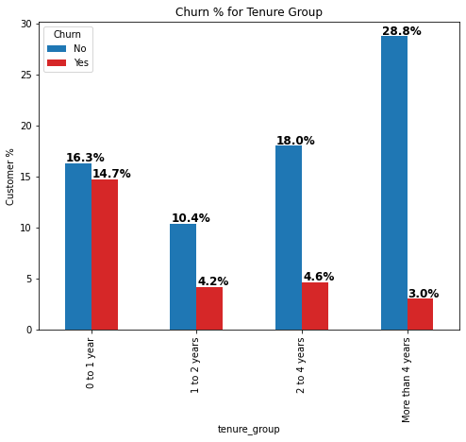
Tenure
Churn count decreases as the tenure increases.
Customers tend to churn within the first few months or within a year.
Let's create 4 tenure groups to check the churn rate more clearly.
Now we can clearly see that the churn rate is high in the 1st year.

Slide 13
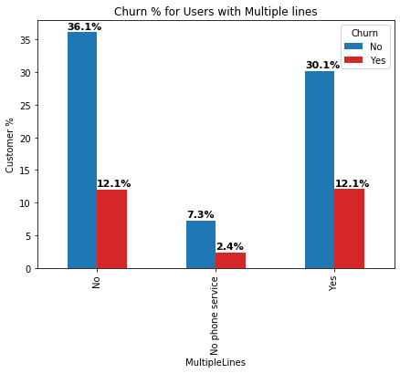
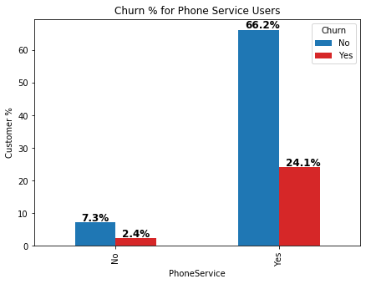
Phone Service
Customers having phone service have a higher churn rate.
2. Service specific attributes -
Phone
Multiple lines
Customers having multiple lines or not does not affect the churn rate.
Customers without phone service tend to churn less.

Slide 14
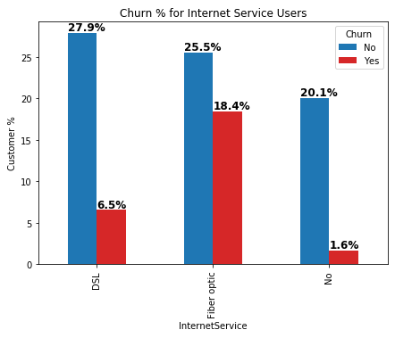
Internet Service
Customers with fiber optic connection have a higher churn rate.
II. Internet

Slide 15
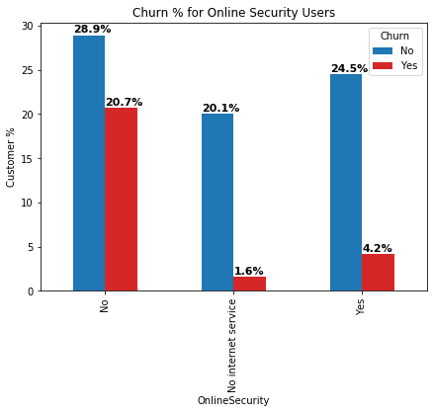
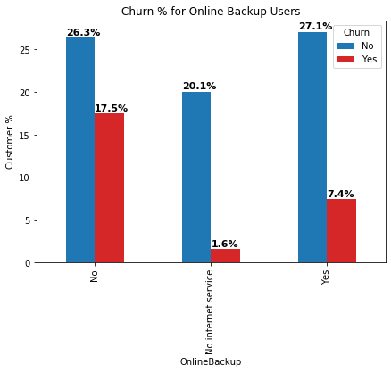
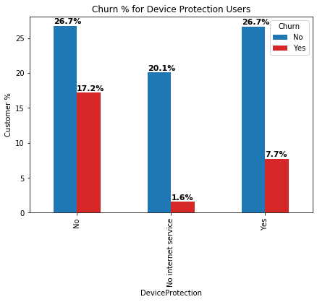

Customers who do not have Online Security, Online Backup, Device Protection & Tech Support have higher churn rate.
Online Security
Online Backup
Device Protection
Tech Support

Slide 16
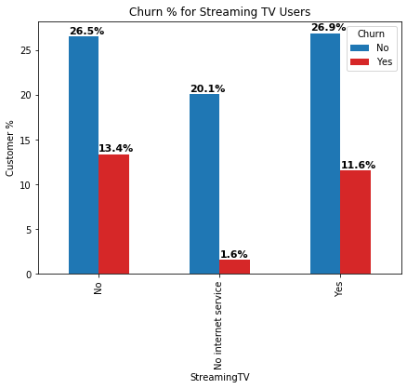

The churn rate do not have a big difference between the customers having the service of Streaming TV & Streaming Movies or not.
Streaming TV Streaming Movies

Slide 17
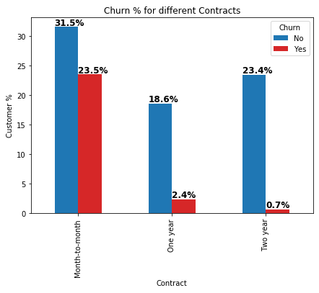
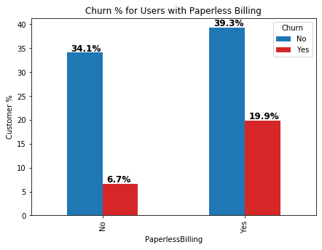
Contracts
Customers having Month-to-Month contracts have a high churn rate.
3. Money specific attributes -
Paperless billing
Customers with paperless billing tend to churn out more.

Slide 18
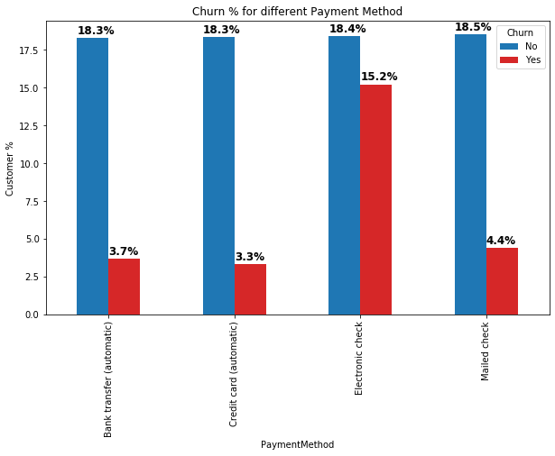
Payment method
Customers who pay electronic check have a high churn rate.

Slide 19
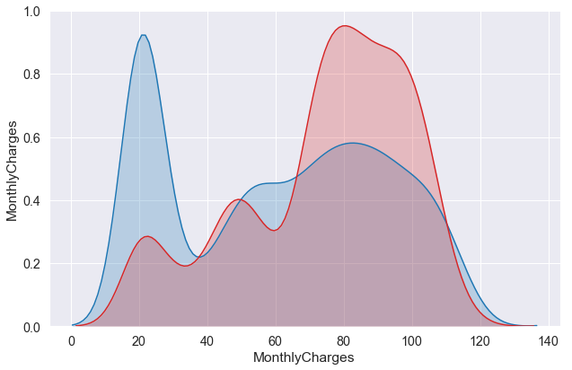
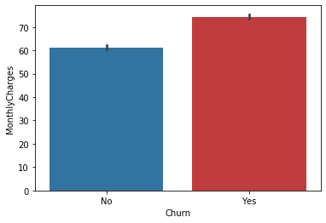

Monthly charges
Churn rate increases as Monthly Charges increases.

Slide 20
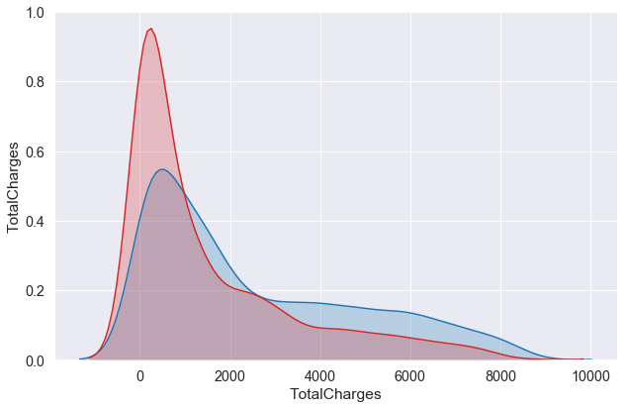
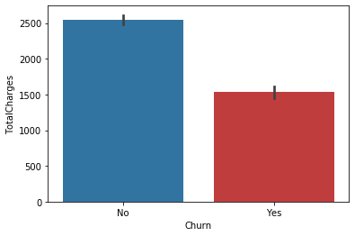
Total charges
Churn rate decreases as Total Charges increases.

Slide 21
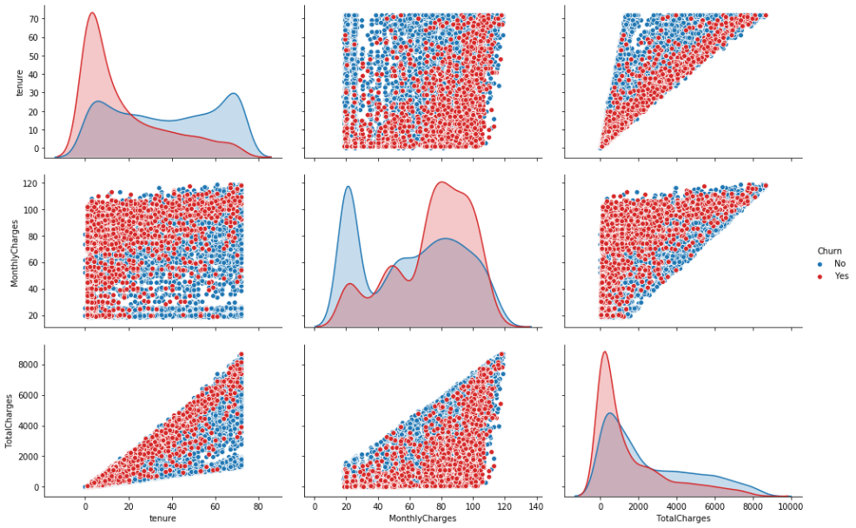
Relationship between the numeric columns with respect to Churn:

Slide 22
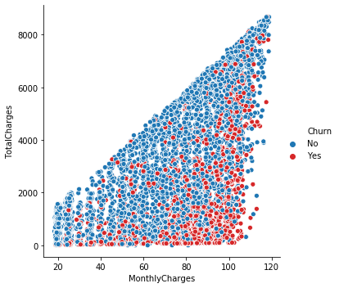
Total Charge increases as the Monthly Charge increases.
Churn is mainly towards the bottom which indicates that churn increases with increase in monthly charge.
Monthly Charges and Total Charges by Churn

Slide 23
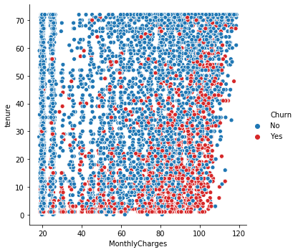
Monthly charges may or may not increase with tenure.
Again we can see that churn increases with increase in monthly charge.
Monthly Charges and Tenure by Churn

Slide 24
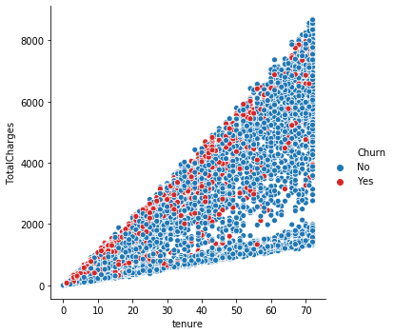
Total charges increases with tenure.
Churn rate does not increase so much with increase of either total charge or tenure.
Total Charges and Tenure by Churn

Slide 25
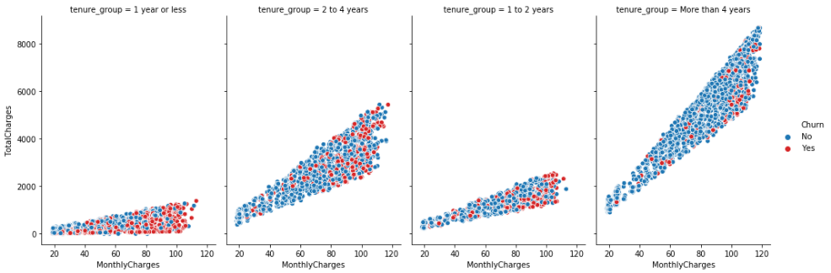
This clearly indicates that the churn rate is high within the 1st year and also it increases with monthly charge.
Monthly Charges, Total Charges and Churn by Tenure groups

Slide 26
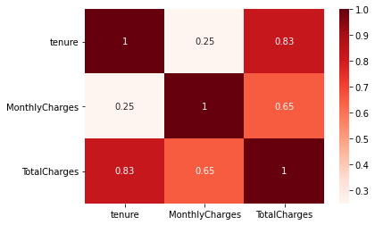
Correlation between the numeric columns:
Tenure is highly correlated with total charge.
Monthly charge is moderately correlated with total charge.

Slide 27
Inferential Statistics
Here we apply statistical tools to gain some inferences and insights into the data and discover relationships between various features of our dataset with the target variable by hypothesis testing.
We use Chi-square test of independence of variables in a contingency table.

Slide 28
The following results were obtained:
Gender has no influence on churn.
Senior Citizen has influence on churn.
Partner has influence on churn.
Dependents has influence on churn.
Tenure has influence on churn.
Phone Service has no influence on churn.
Multiple Lines has influence on churn.
Internet Service has influence on churn.
Online Security has influence on churn.
Online Backup has influence on churn.
Device Protection has influence on churn.
Tech Support has influence on churn.
Streaming TV has influence on churn.
Streaming Movies has influence on churn.
Contract has influence on churn.
Paperless Billing has influence on churn.
Payment Method has influence on churn.
Monthly Charge has influence on churn.
Total Charge has no influence on churn.

Slide 29
MACHINE LEARNING
We train & test our data using machine learning models to see the performance of our models.
First we split the data into training and test sets on a 80:20 ratio and then train the models with default parameters.
The classifiers we choose to train and test our data are:
Logistic Regression
K-Nearest Neighbors
Support Vector Machine
Decision Tree
Random Forest
Gaussian Naive Bayes

Slide 30
The accuracy of the classifiers with default parameters are:
CLASSIFIER | ACCURACY SCORE
Logistic Regression | 79%
K-Nearest Neighbors | 76%
Support Vector Machine | 79%
Decision Tree | 71%
Random Forest | 77%
Gaussian Naive Bayes | 73%
Logistic Regression and SVM performed the best with an accuracy of 79% and Decision Tree performed the worst with an accuracy of 70%.

Slide 31
Parameter Tuning:
Now we try to improve the performance of the models with parameter tuning. We use both Grid Search CV and Randomized Search CV.

Slide 32
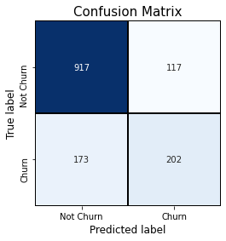
Logistic Regression:-
The following parameter was tuned:
'C': [0.001, 0.01, 0.1, 1, 10, 100]
The best value obtained was C = 0.1.
We got a slight increase of 0.28% in accuracy.
Accuracy = 79%
Confusion matrix =
Precision = 63%
Recall = 54%
f1-score = 58%
AUC = 82%
Feature importance = Monthly charge is highly positively related with churn whereas tenure, phone service & contract are highly negatively related to churn.

Slide 33

K-Nearest Neighbors:-
The following parameter was tuned:
'n_neighbors': (1 to 49)
The best value obtained was n_neighbors = 38.
We get an increase of 2.6% in accuracy.
Accuracy = 78%
Confusion matrix =
Precision = 61%
Recall = 52%
f1-score = 56%
AUC = 81%

Slide 34
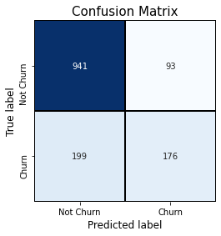
Support vector Machine:-
The following parameters were tuned:
'C': (1 to 19)
'kernel': ['linear', 'poly', 'rbf', 'sigmoid']
gamma': ['scale', 'auto']
The best values obtained were C = 1, kernel = 'rbf', gamma = 'scale'.
Accuracy remains the same.
Accuracy = 79%
Confusion matrix =
Precision = 65%
Recall = 47%
f1-score = 55%
AUC = 78%

Slide 35

Decision Tree:-
The following parameters were tuned:
'max_depth': (2 to 6)
'max_features': (1 to 20)
'min_samples_leaf': (1 to 19)
'criterion': ['gini', 'entropy']
The best values obtained were min_samples_leaf = 4, max_features = 13, max_depth = 5, criterion = 'entropy', random_state = 10.
We get a huge increase of 7.24% in accuracy.
Accuracy = 79%
Confusion matrix =
Precision = 65%
Recall = 45%
f1-score = 53%
AUC = 81%
Feature importance = We get tech support and monthly charges highly related to churn.

Slide 36

Random Forest:-
The following parameters were tuned:
'max_depth': (2 to 6)
'max_features': ['sqrt']
'min_samples_leaf': (1 to 19)
The best values obtained were min_samples_leaf = 13, max_features = 'sqrt', max_depth = 6.
We get an increase of nearly 2.4% in accuracy.
Accuracy = 79%
Confusion matrix =
Precision = 67%
Recall = 45%
f1-score = 54%
AUC = 83%
Feature importance = We get contract and tenure highly related to churn.

Slide 37
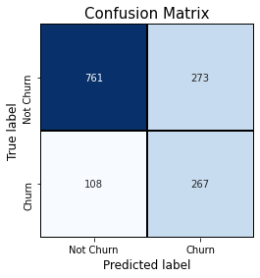
Gaussian Naive Bayes:-
No parameters were tuned here.
So the accuracy remains the same.
Accuracy = 73%
Confusion matrix =
Precision = 49%
Recall = 71%
f1-score = 58%
AUC = 80%

Slide 38
The accuracy of the classifiers after tuning the parameters are:
CLASSIFIER | ACCURACY SCORE
Logistic Regression | 79% (0.23%↑)
K-Nearest Neighbors | 78% (2.6%↑)
Support Vector Machine | 79%
Decision Tree | 79% (7.24%↑)
Random Forest | 79% (2.4%↑)
Gaussian Naive Bayes | 73%

Slide 39
Voting Ensemble:
We now use the Voting Classifier to combine all the above mentioned machine learning classifiers. The models are pitted against each other and selected upon best performance by voting. Such a classifier can be useful for a set of equally well performing model in order to balance out their individual weaknesses.
The voting ensemble gives an accuracy score of 80%.

Slide 40
CONCLUSION
Recommendations to retain the customers:
Take the following actions immediately:
Try striking a longer contract with new customers: two year or more.
Lower the monthly charges.
Leverage the time to improve the quality of services, on the high cost ones like fiber optic.
Improve on the Technical support on all services like streaming, phone connection and internet. Be up-to-date with current technology.
Collect customer feedback and act on it immediately to prevent new customer churn.
Next: It will be helpful to get more features to understand the behaviour of the customers according to location and different service providers.

Slide 41
Scope for future work:
More predictive models could be tried. However, there is no guarantee of better accuracy, as we have seen similar accuracy with logistic regression, decision tree and random forest. This actually means most of the variance in the data is explained.
One could collect more data through surveys, analyze them using NLP techniques and take more measures.
There is a scope to collect historical data on company customers over a few decades, and fight out clear reason for customer drop.

Slide 42
Thank You

